Slide 1







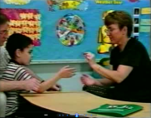

Speech and Language Therapists work with:
ICD11: Social communication and interaction deficits; restricted/repetitive behaviour; onset in childhood though symptoms may manifest later. Web.
DSM5: (A) Social communication and interaction deficits; (B) restricted/repetitive behaviour; (C) symptoms present early; (D) symptoms cause significant impairment to social/occupational/ other function; (E) not explained by intellectual disability/delay. Web.
NAS diagnosis info. Web.
Additional
slides
Speech and Language
Therapy Process
{
language:
  vocabulary
  structure
  social use
speech and voice
stammering
All aspects of communication including:
Referral
Referral can come from: school, parents/carers, or others;
Permission must be given by someone with parental responsibility;
Take on referral if appropriate – otherwise signpost to other services.
“Sabotage”
Intensive interaction
Assessment
Visual
Timetable
Social Stories
“Here are some sweets”
Detailed timetable
This lecture will start at 11.05am, the first part of the lecture will last for 40 minutes, then we will have a break of 10 minutes. The second part of the lecture will last for 35 minutes. At 12.35pm we will have informal questions until 12.50pm. We will leave the lecture theatre at 12.50pm.
Follow the child’s lead;
Copy back;
Try adding something (e.g. an extra drum beat);
Could use to develop turn-taking.
Assessment – When
At initial referral and at other points to evaluate therapy and re-evaluate the nature of their needs.
Assessment – What
All aspects of the child’s communication including:
“Draw a picture”
Assessment – Why
To find out if there is a problem, to determine what to work on, to assess the effectiveness of the therapy
Language comprehension;
Language expression;
Play, language in play;
Speech
Social use of language:
* gaining attention
* commenting
* requesting
* recounting information
* giving instructions
* adjustment of language according to the context
Assessment - how
Discussions with teacher, teaching assistants, parents etc. to find out the nature of their current concerns;
Observation in class, and other environments:
Assessment of child’s skills in 1:1 situation – often using toys or picture materials
FORM
Word forms of a language
Sounds used in a language
Syntax of the language (how words are connected together to form phrases and sentences)
CONTENT
The assignment of meanings to words and sentences in a language
Words and sentences which a person can use and understand to convey and receive information
Speech and Language Therapy and Autism
Neil Thompson, Commtap CIC
[TEACCH]
Structured uncluttered environment – clear areas for work and for leisure;
Clearly structured day using timetables;
Work to be done, and work finished baskets;
Some aspects of this may be difficult to achieve in a typical primary classroom.
Acronym is: Treatment and Education of Autistic and related Communication-handicapped Children
Goals/targets
Functional – i.e. addressing the child’s needs or what they might need in the future
SMART – specific, measurable, achievable, relevant, time limited
Integrating with the school curriculum (Commtap)
Always ask “so what?”
USE
How language is used
Functions for which a person is able to use language (for example: gaining attention, commenting, requesting information, recounting information, giving instructions)
Social use of language
Ability to adjust language according to the social context
Goals – examples
Use a picture to make a request;
To only say nice things about what people look like;
To talk about something that just happened.
Social Skills
For example:
proximity when speaking;
turn taking;
listening and responding;
rules and strategies for dealing with different situations – learning versus understanding social situations.
Example communication behaviours
During development: periods of silence or production of apparently meaningless sounds;
Child may suddenly start to use imitated utterances;
Echolalia;
Delayed echolalia.
Difficulties integrating the form of language with language content;
Difficulties in the social use of this language;
In severe cases, failure to develop a link between language/symbols and communication.
Eye gaze and body posture differences in interactions;
Failure to integrate context into the understanding of language, literal language understanding (e.g. “Pull your socks up”);
Speech sound development: appears to be similar to typical development;
Unusual intonation and stress patterns common.
Initiating and terminating interactions;
Maintaining conversational topics;
Functioning within speaker and listener roles;
Using behaviours for the purpose of communication.
Activities
Suggest some activities for working towards the goals.
PECS
Picture Exchange Communication System
Aims to make the process of communication with symbols as explicit as possible;
Requests: we usually ‘exchange’ a spoken word for a requested item;
Spoken words are abstract and transient
That words represent something – and they can be directed to someone – are significant learning steps for a child
Picture symbols:
PECS Phase 2
Travelling
indicates no given a choice | indicates no given a choice
understand single words | understand single words
use a visual timetable | use a visual timetable
make initiations to join activities | make initiations to join activities
to use four word phrases | to use four word phrases
[Some special considerations]
echolalia;
- can be immediate or delayed;
- simple or quite sophisticated: learnt phrases, phrases out of context, learnt conversations;
- may have a variety of functions – e.g. answering ‘yes’, requesting, maintaining conversational turn.
linking symbols (e.g. spoken word) to communication;
hypo- and hyper- sensitivity to stimuli (e.g. noises, movement, light, smell).
Have a book with the symbols inside – the symbol being used is put on the front;
The person the child needs to communicate with moves further away;
The book is moved further away – to a point where it is kept somewhere in the classroom/home where the child needs to get it.
Training/Advice
Work with school staff/parents and the child, to enable them to use appropriate activities with the child;
The amount of repeat visits the speech and language therapist makes will vary.
PECS Phase 1
Establishing the exchange - no symbolic understanding is required at this stage
Requires two adults:
- One sits behind the child to prompt them
- The other is the communication partner
Establish motivator;
Child plays with motivator for short time;
Place card in front of child;
Partner now has the motivating item;
Prompter physically assists child to put picture in partner’s hand;
Immediately, partner hands item to child saying its name at the same time.
PECS Phase 3
Symbolic understanding
Example communication methods
Cry/scream;
Body positioning in relation to things he is interested in;
May take someone’s hand to get things done for him;
Look at things he wants;
Reach for things he wants;
Point but not look at parent;
Use joint attention;
Use gestures/facial expressions/sounds/ words/ sentences;
Use pictures;
Use echolalia.
Use two pictures and two objects: a preferred item and an item of no interest
Always give the child the item indicated in the picture he/she passes
To develop the selection of the appropriate picture you could:
- Use prompts (similar to before)
- Differentiate the pictures in location or size and slowly reduce the differentiation
Becoming a Speech and Language Therapist
3-4 year undergraduate course, or…
Two year postgraduate course
- Requires undergraduate degree – typically second class or better: a wide range of degrees are considered
Refs
Assistant gives minimum prompts for child to achieve what they want (to get the motivating item)
Time should be given so that the child has the opportunity to make a response (but not so much that they become frustrated)

Slide 2
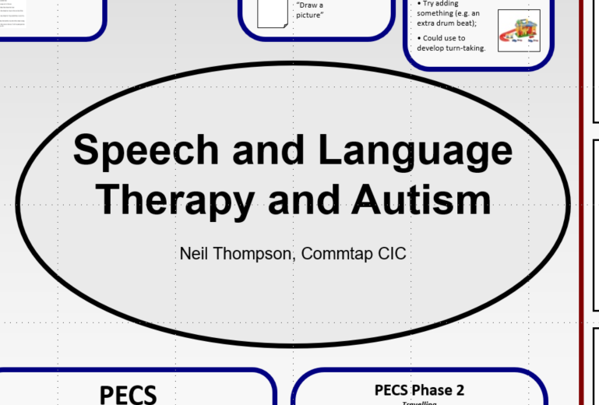

Slide 3
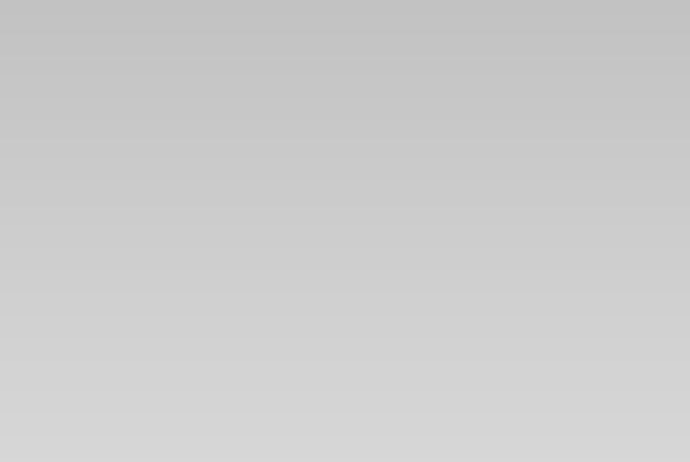
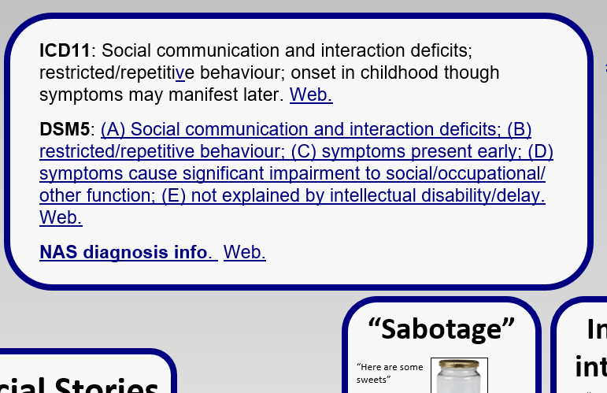

Slide 4
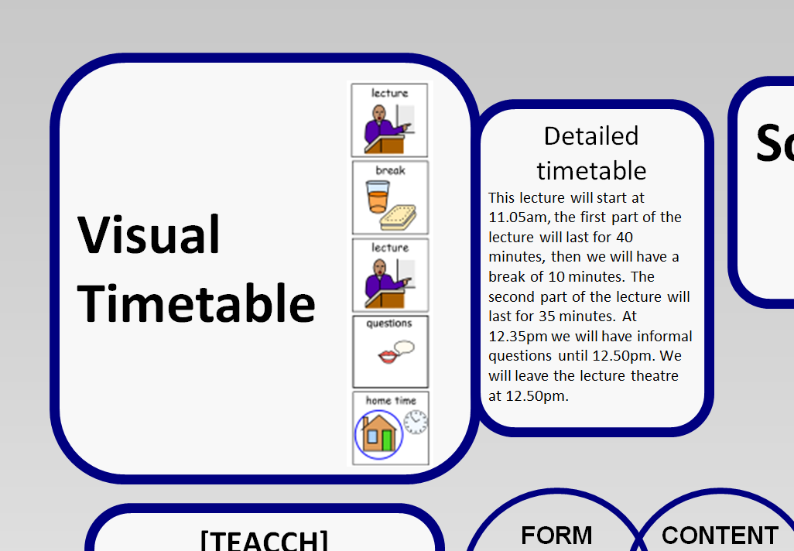
YouTube Local
Places1 Places2
Notes:
Use of visual timetable;
Pictures for use at transitions;

Slide 5
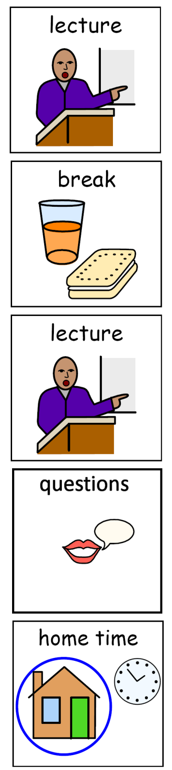

Slide 6
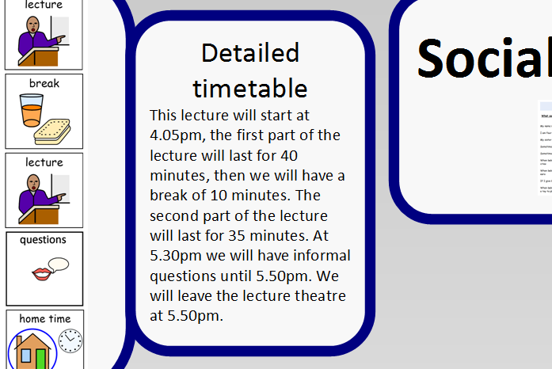

Slide 7
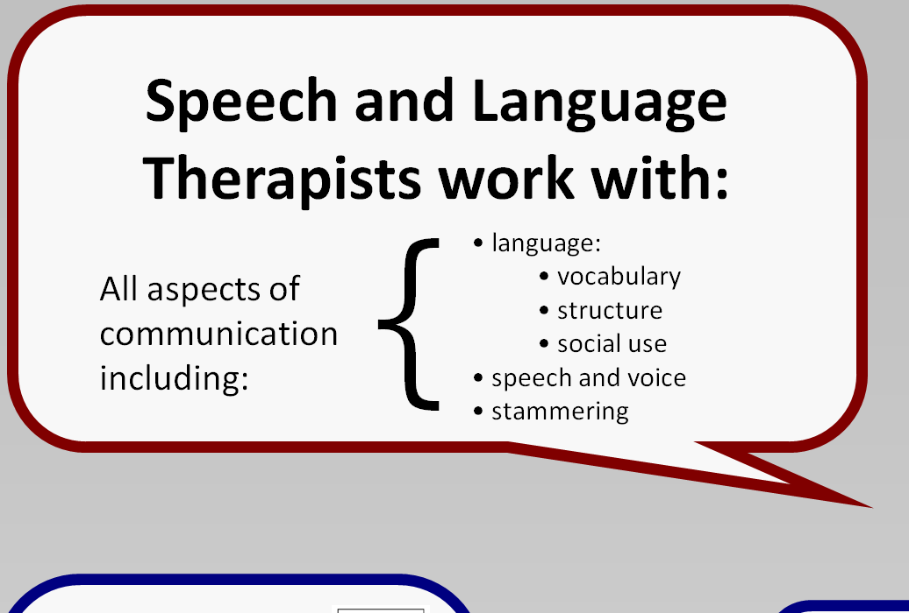

Slide 8
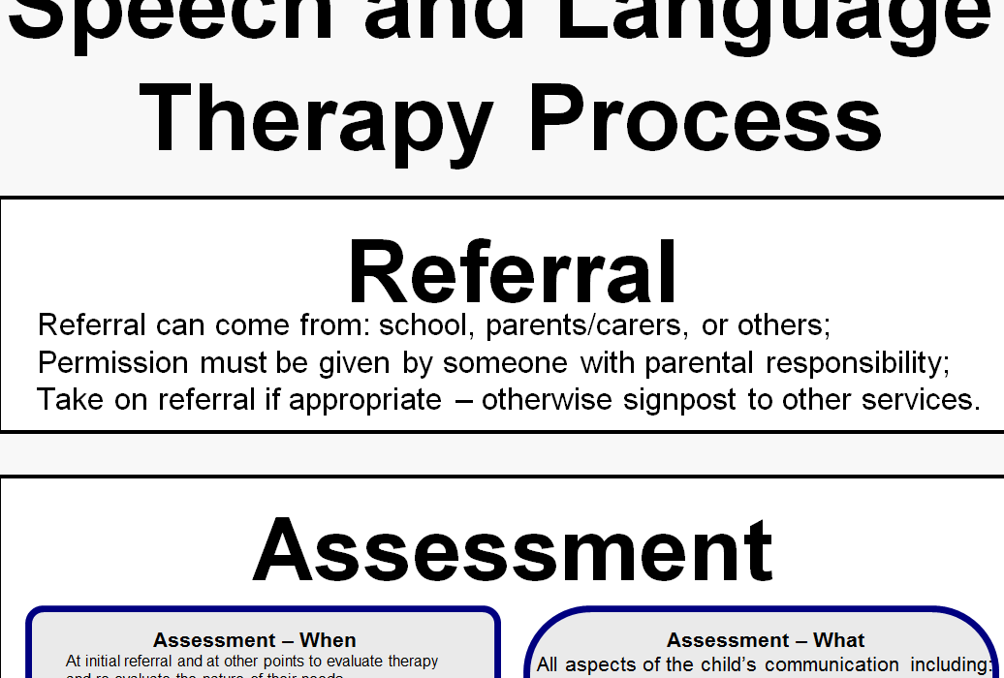

Slide 9
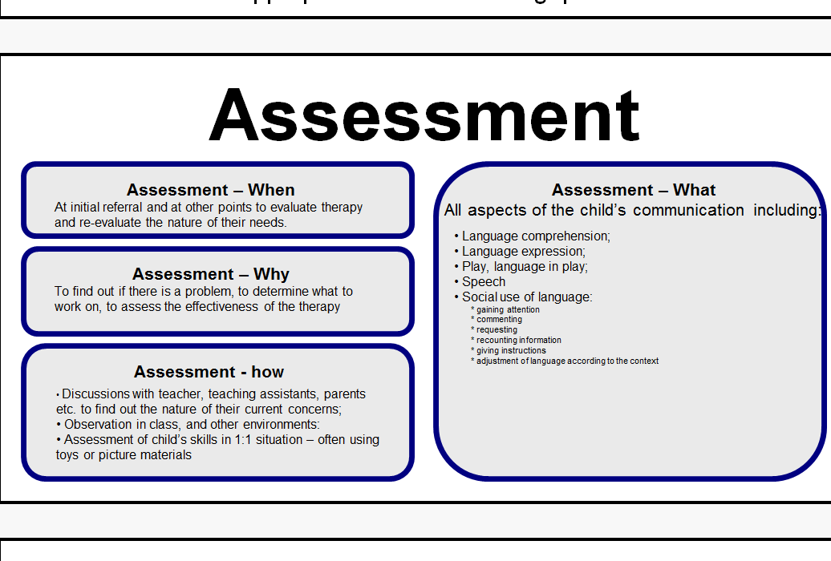

Slide 12
Online Info Local info

Slide 15
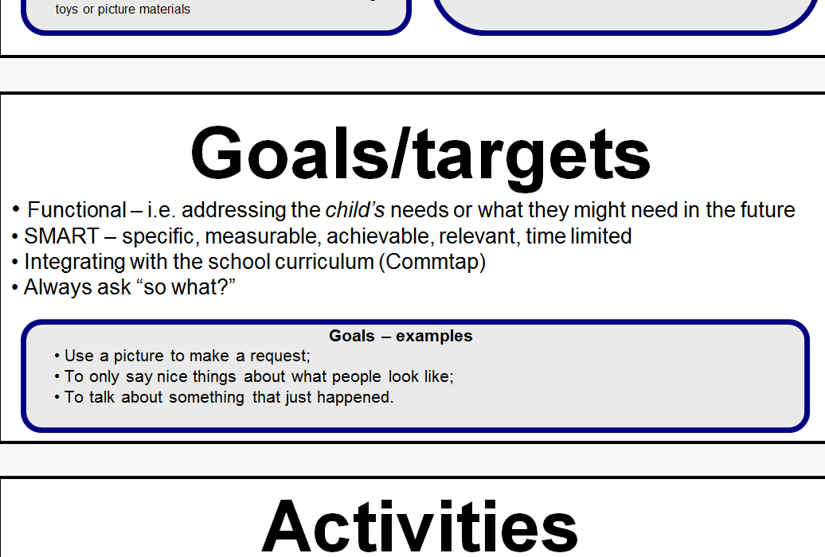

Slide 17
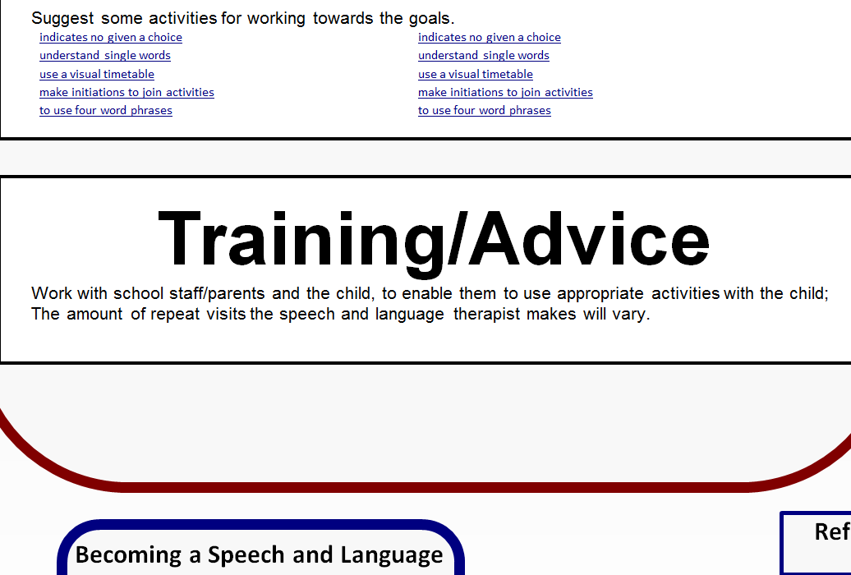

Slide 19
indicates no given a choice | indicates no given a choice
understand single words | understand single words
use a visual timetable | use a visual timetable
make initiations to join activities | make initiations to join activities
to use four word phrases | to use four word phrases

Slide 20
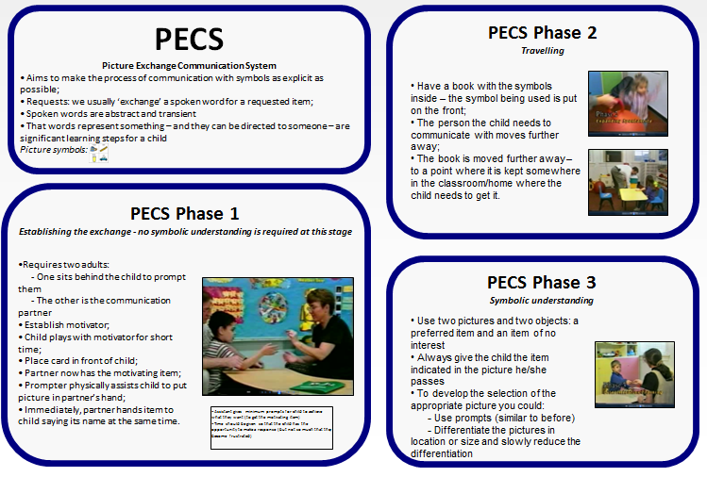

Slide 21
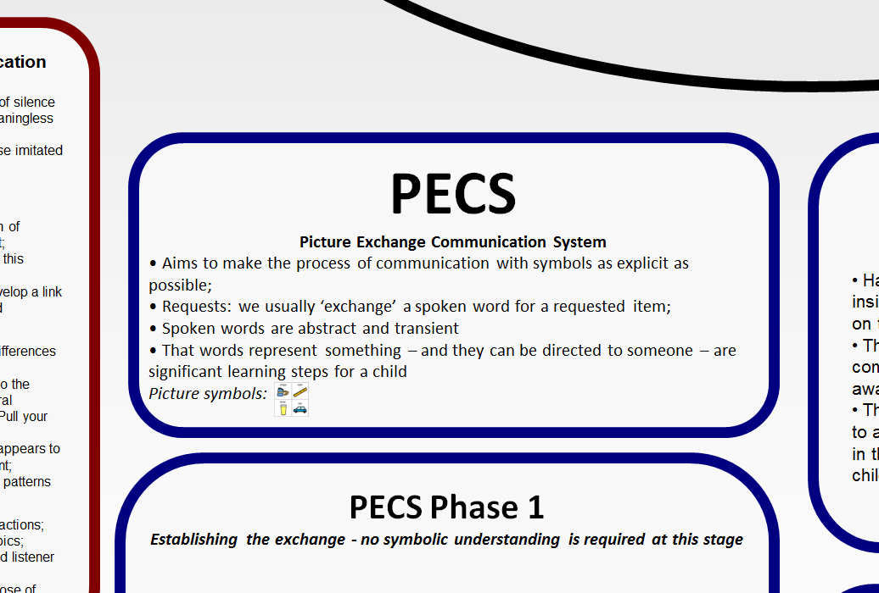

Slide 22
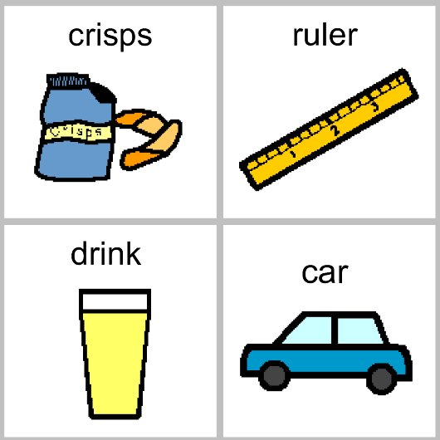

Slide 28
Lego therapy: YouTube Local

Slide 29
YouTube Local

Slide 30
YouTube Local

Slide 33
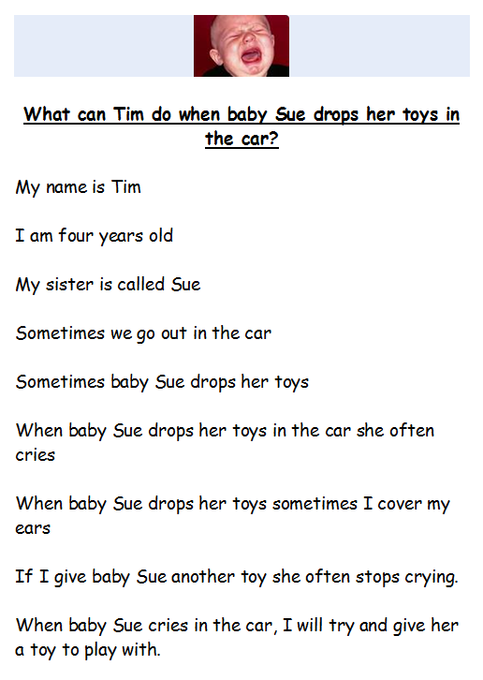

Slide 35
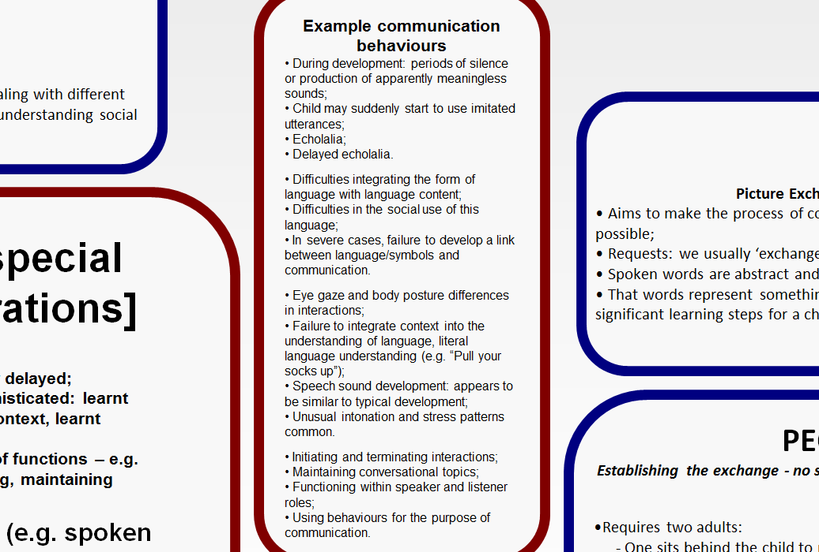

Slide 46
References
Ayres, A. (1979). Sensory integration and the child. Los Angeles: Western Psychological Association.
Bernstein, D., & Tiegerman, E. (2001). Language and Communication Disorders in Children (Fifth ed.): Allyn and Bacon.
Bloom, L., & Lahey, M. (1978). Language development and language disorders. New York: Macmillan.
Bogdashina, O. (2005). Communication Issues in Autism and Asperger Syndrome. London: Jessica Kingsley.
Commtap (2012). Targets and Activities Project: Activities for Children’s Communication. www.commtap.org
Malcomess, K. (2005). Care Aims. www.careaims.com/index.php?page=care_aims
Potter, C., & Whittaker, C. (2002). Enabling Communication in Children with Autism. London: Jessica Kingsley.
Prizant, B., & Duchan, J. (1981). The functions of immediate echolalia in autistic children. Journal of Speech and Hearing Disorders, 46, 241-249.
Pyramid Educational Consultants. (200?). An Introduction to PECS. Schopler, E., & Mesibov, G. (1984). Helping autistic children through their parents: the TEACCH model. In E. Schopler & G. Mesibov (Eds.), The Effects of Autism on the Family. London: Plenum.
Wetherby, A. M. (2006). Understanding and Measuring social Communication in Children with Autism Spectrum Disorder. In Charman, T. & Stone, W., Social and communication development in autism spectrum disorders : early identification, diagnosis, & intervention. New York: The Guilford Press
Widgit Software (2012) Software Solutions for Inclusion. www.widgit.com

